Slide 1

Big Mountain Resort Montana
Pricing strategy Model
By: Libi VOSHIN

Slide 2
Problem Identification and how can we help
What price should you currently charge for a ticket?
How to capitalize on resort’s facilities as much as you could?
Which of the considered changes, will cut costs or support an even higher ticket price?
How to adjust your ticket price based on future changes.
Problem Identification
Notes:
Our data science team was brought in to implement a data-driven model that would help to answer the following business questions:
Recently resort invested in an additional chair lift, which has increased its operating costs by M$1.54 this season. Including this new addition, to maximize its returns relative to its position in the market, we investigated What price should Big Mountain Resort currently charge for their ticket?. Now, the resort's pricing strategy has been to charge a premium above the average price of alternatives in its market segment. This report will present answers to whether they can increase the price even higher and, if so, how much?
We will be helping to determine How the resort can capitalize on its facilities in the best possible way. Resort's management has presented us with several changes that they are considering. Our model tested these propositions and predicted how each scenario would influence current consumer’s willingness to pay for a ticket. I will present Which of the considered changes will cut costs without undermining the ticket price or support an even higher ticket price.
And finally, based on the data we have on the existing list of facilities, we will provide a user-friendly model that would support future business decisions How to adjust your ticket price based on those changes.

Slide 3

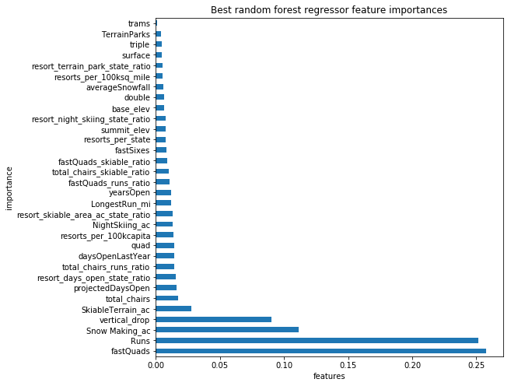
Recommendations and key findings
On the Basis of:
Each visitor on average buying 5-day tickets
Each year there are about 350,000 visitors at the resort
Our modelling suggests charging $94.22 per ticket
Solely to cover resort’s recent investment, price should be raised in $0.88 per ticket.
Features that came up as highly valued by costumers:
Number of Fast Quads
Number of Runs
Snow Making area
Vertical drop
Skiable terrain area
Total number of chairs
Recommendations and key findings
Notes:
On the basis of each visitor on average buying 5-day tickets and each year there are about 350,000 visitors at the resort, Our modelling suggests that charging $94.22 per ticket could be fairly supported in the marketplace by Big Mountain's facilities. Solely to cover resort’s recent investment, price should be raised in $0.88 per ticket.
Features that came up as highly valued by costumers (see Appendix A), include:
Number of Fast Quads
Number of Runs
Snow Making area
Vertical drop
Skiable terrain area
Total number of chairs
After seeing where Big mountain resort stands amogst all in those ereas, we feel confident that existing resorts’ facilities can support the higher ticket price.

Slide 4
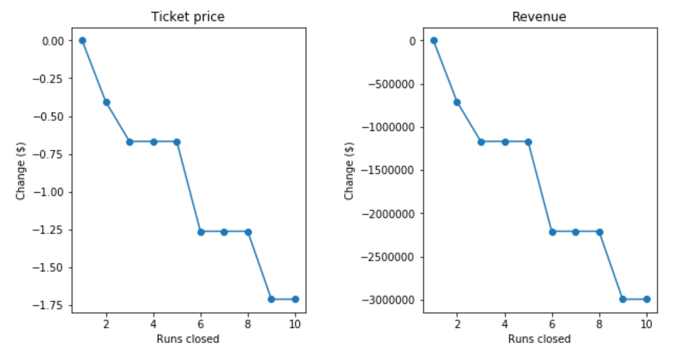
Recommendations and key findings
1. Permanently close down the least used run
3. Assess runs’ operational costs and make decision according this decision table:
Yearly operational costs of: | Permanently close down:
2 runs > $675K | 2 least used runs
5 runs > $ 1.225 M | 5 least used runs
8 runs > $ 2.2 M | 8 least used runs
2. Increase the vertical drop in 150 feet by adding additional lower run
~$3.48 M Yearly Revenues
$2 M Yearly profit
- 1.45 M Chair-lift Operational Cost
~$1.99 Increase in ticket price
Should we add 2 acres of snow making coverage?
Recommendations and key findings
Notes:
For further improvements, we would recommend the following:
1. First, to permanently close down the one least used run, as it has shown from the model that it is not reducing ticket value.
2. Then, our model shows that increasing the vertical drop in 150 feet by adding additional lower run, supports a $1.99 increase in ticket price which over the season this could be expected to amount to revenue of $3.475 M. Implementation of this scenario requires the installation of an additional chair lift to bring skiers back up. Resort’s previous experience shows that price should be raised in $0.88 per ticket to cover additional chair-lift yearly operational costs. Hence, It is an extra profit of more than $2M (not including the additional chair lift installation cost). Note, that only after knowing the additional chair lift’s yearly operational costs, we could calculate the profit. It is also worth to mention that adding 2 acres of snow making coverage make no difference on ticket value therefore does not worth the investment. 3. Lastly, resort should look up at its runs’ operational costs and make decision when should it permanently close it’s least used runs according to this decision table: Yearly operational costs of - 2 runs > $675K. Permanently close down - 2 least used runs. Etc..
As we can see in the graph below, If Big Mountain closes 3 runs, it seems they may as well close down 4 or 5 as there's no further loss in ticket. so as 6,7 and 8.

Slide 5
Model was based on the following assumptions
Our Model considers all resorts within all the given states, together
All provided resorts belonging to the same market share
Our Model focuses only on predicting weekend ticket prices
In Montana it is customary to match weekend and weekday ticket prices
After deriving state-wise statistic features out of 330 resort records, Our Model uses 277 resort records
Dropped all rows with missing price information
No clear grouping that would justify for treating states differently
Weekend prices have the least missing values of the two
Dropping another resort record for unclear data
Dropping “Number of FastEight seats” featured column
Modeling results and analysis
Notes:
Model was based on following assumptions:
* All provided resorts belonging to the same market share suggests that prices should be similar amongst them
* Haven't seen any clear grouping that would justify for treating states differently
-> We built our model to considers all resorts within all the given states, together.
* Although some States have weekend prices far higher than weekday prices, In Montana it is customary to match weekend and weekday ticket prices.
* After cleaning all rows that were missing pricing information, between weekday and weekend prices, Weekend prices have the least missing values of the two
-> Our model focuses on the weekend prices.

Slide 6
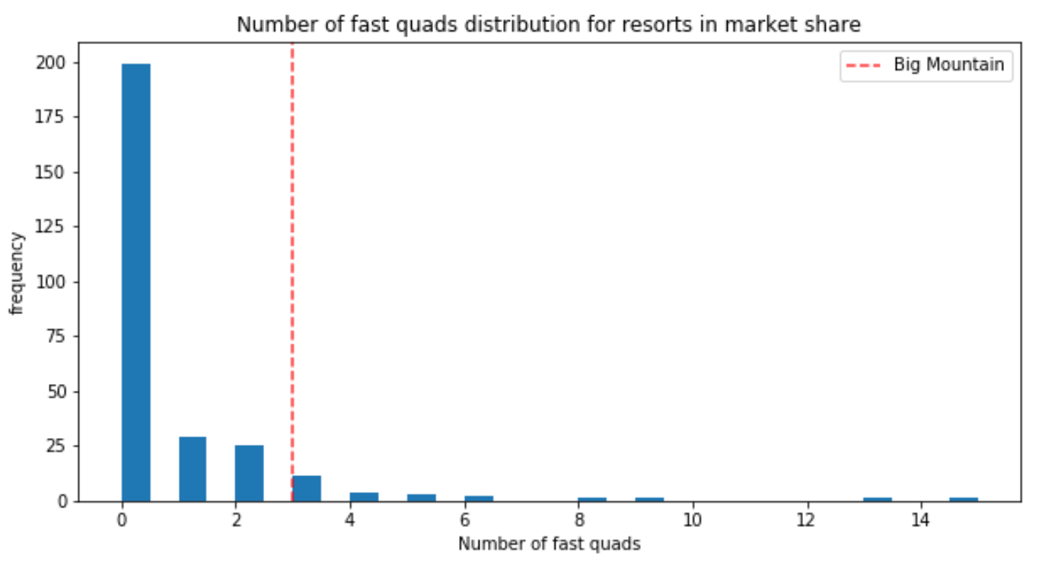
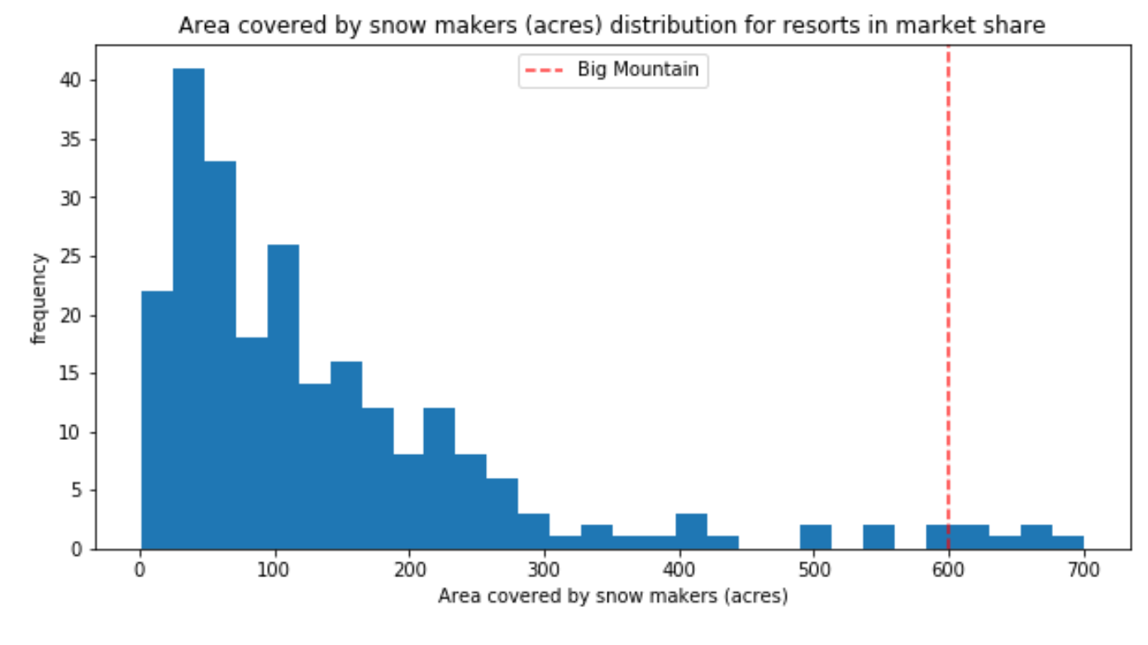
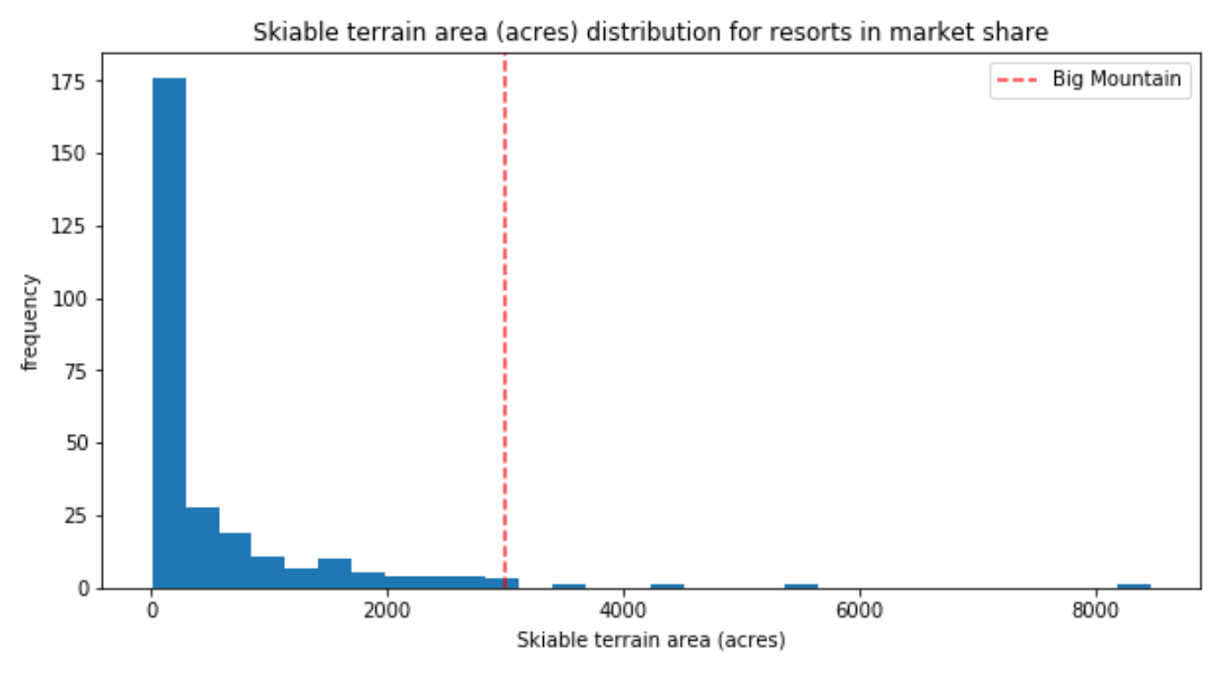
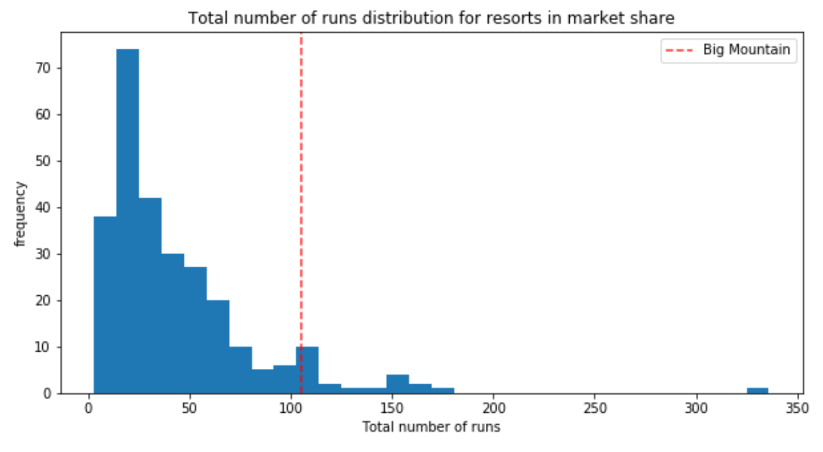
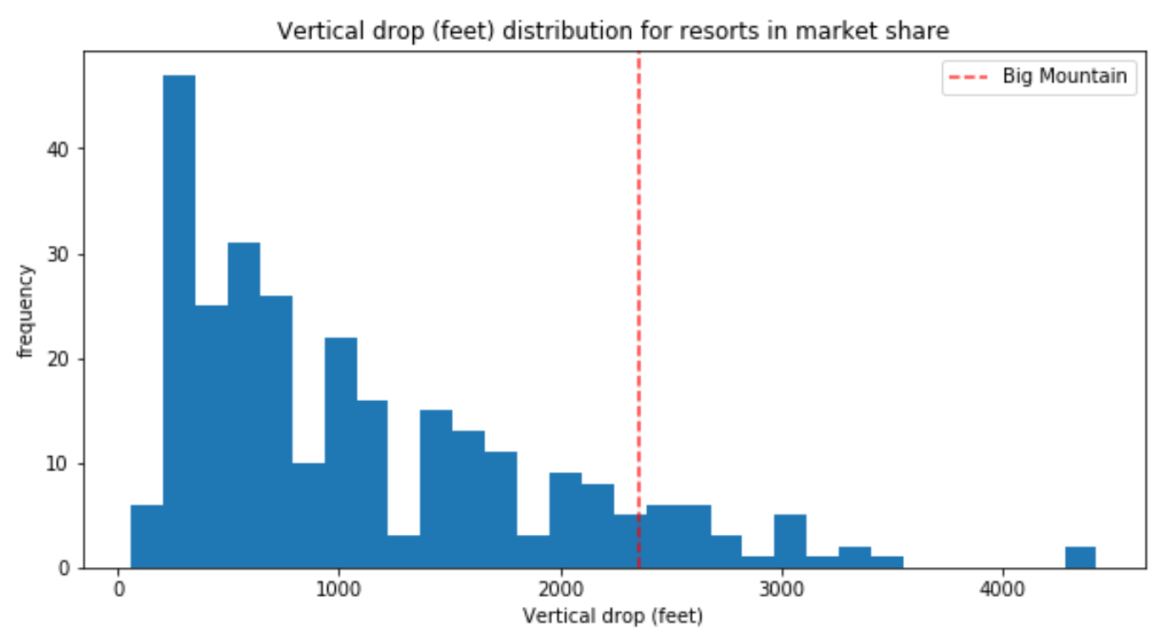
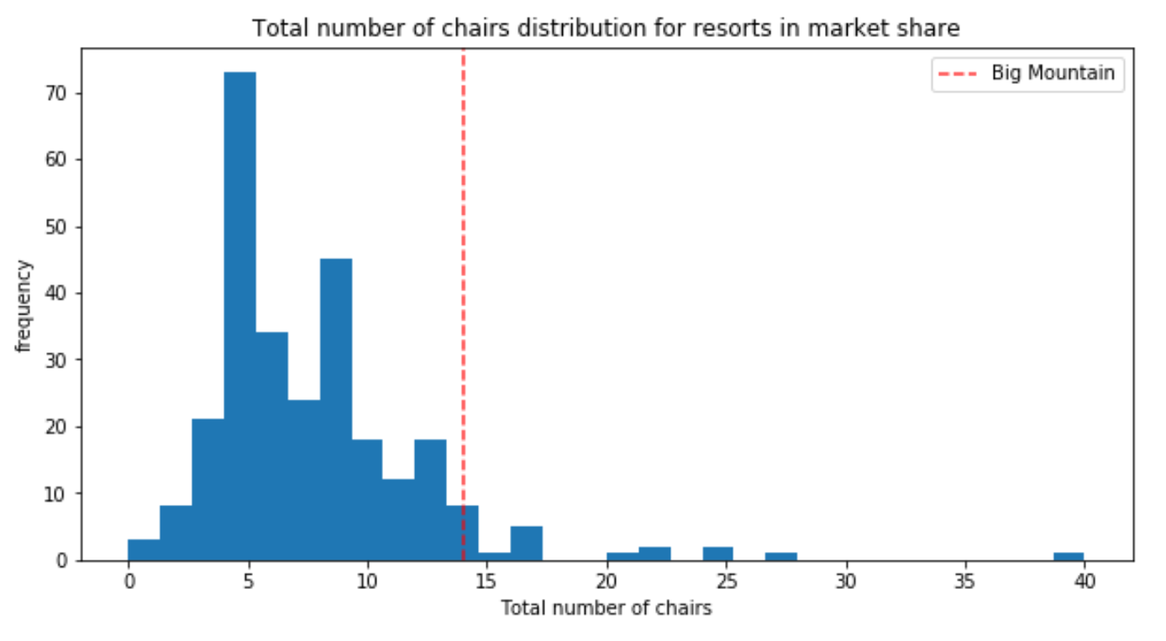
Modeling results and analysis
Area covered by smow makers (acres) distribution
Number of fast quads distribution
Skiable terrain area (acres) distribution
frequency
Total number of runs distribution
Vertical drop (feet) distribution
Total number of chairs distribution
frequency
Modeling results and analysis
Notes:
Features that came up as highly valued by costumers (see Appendix A), include:
Number of FastQuads - Most resorts have no fast-quads, Big Mountain has 3.
Runs - Big Mountain compares well for the number of runs
Snow Making area – Big Mountain resort is very high up the league table of snow making area.
Vertical drop - Resort is doing well, and there are only several others with a greater drop
Skiable terrain area - Big Mountain is amongst the resorts with the largest amount of skiable terrain.
Total number of chairs - Big Mountain has amongst the highest number of total chairs
Big mountain resort stands amongst all in those areas, we feel confident that existing resorts’ facilities can support the higher ticket price.

Slide 7
Choosing the best Model
 | Model | Missing values technic | Standard scale | Selection of K | R^2 Performance | R^2 Performance on Test set Cross Validation on Train set |  | MAE performance +Cross- Validation on Train set
 |  |  |  |  | Train, Test | mean , std | range of R^2 (mean-/+2std) | Train (mean, std) | Test (mean)
1 | Linear Regression | Median | Yes | - | 0.818 , 0.721 | - | - | 8.548 | 9.407
2 | Linear Regression | Mean | Yes | - | 0.817 , 0.716 | - | - |  | -
3 | Linear Regression | Median | Yes | K=10 | 0.767 , 0.626 | 0.6606, 0.0657 | [0.53, 0.79] | 9.502 | 11.202
4 | Linear Regression | Median | Yes | K=15 | 0.792 , 0.638 | 0.6327, 0.0950 | [0.44, 0.82] | 9.21176 | 10.488246
5 | Linear Regression | Median | Yes | K=8 | 0.762, 0.597 | 0.6815 , 0.0459 | [0.59, 0.77] | 10.499, 1.622 | 11.7935
6 | Random Forest | Median | Yes | default | - | 0.6385, 0.1444 | [0.3497 , 0.927] |  | -
7 | Random Forest | Median | None | number trees: 69 | - | 0.7082, 0.0656 | [0.5769 , 0.8395] | 9.659, 1.349 | 9.4955
Modeling results and analysis
Notes:
We built a best linear model and a best random forest model
The random forest model has a lower cross-validation mean absolute error by almost $1 on train set and a lower MAE on test set by more than $2 (Verifying performance on the test set produces performance consistent with the cross-validation results). It also exhibits less variability .

Slide 8
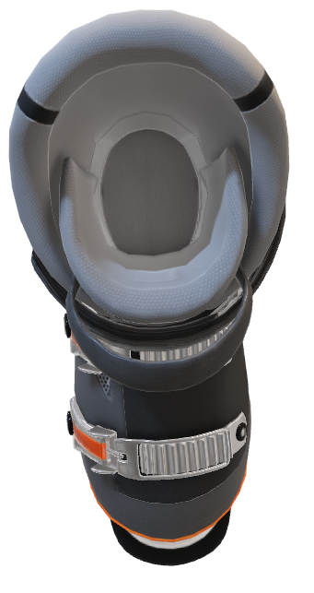
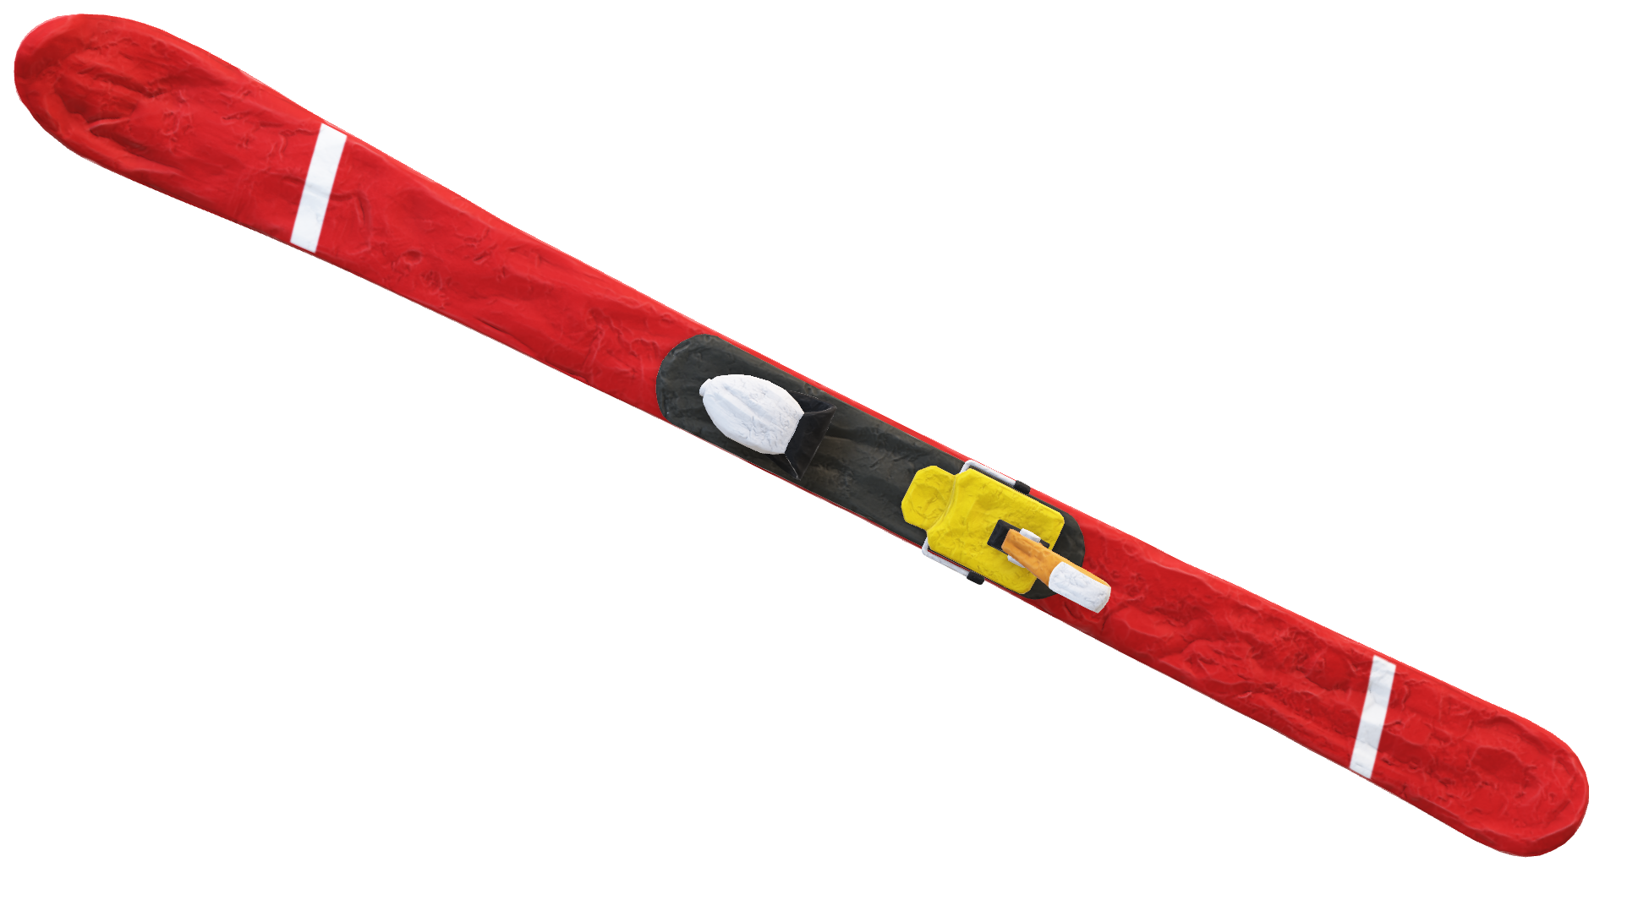
Summary and conclusion

Slide 9
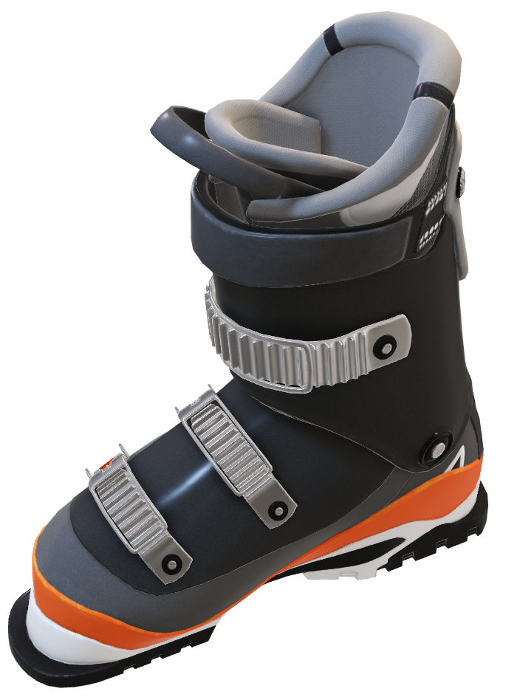
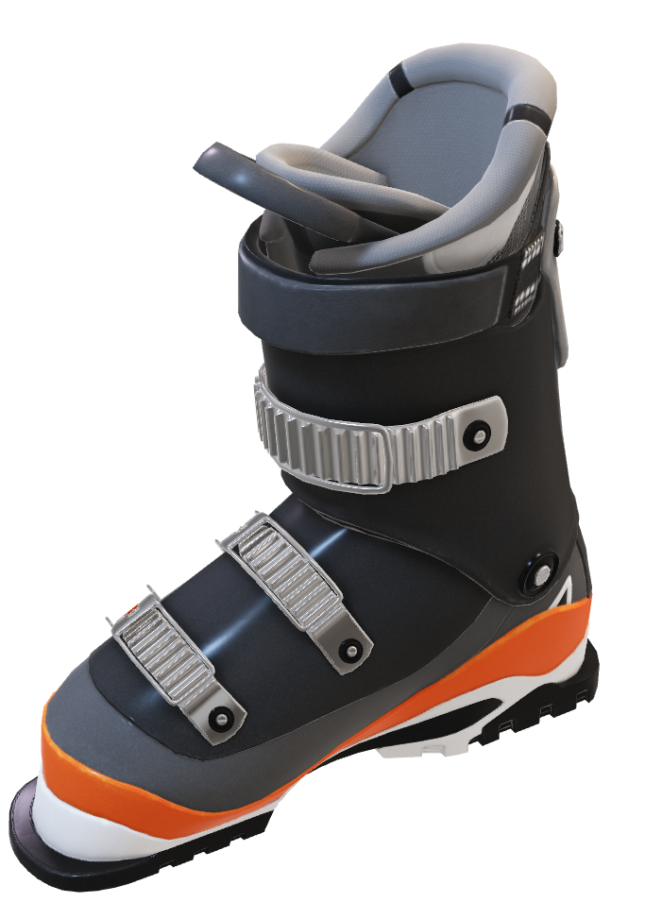


Summary and conclusion
Being able to sense how facilities support a given ticket price is valuable business intelligence
Currently Big Mountain charges
could be fairly supported in the marketplace by Big Mountain's facilities
$81
facilities
Corresponding deltas
Ticket price predicted increase($)
$94
Notes:
Currently Big Mountain charges $81 and although state-wise Big Mountain’s ticket price is the highest and so it sits high amongst all resorts, there are still resorts with a higher price and up to double of the price. Note that this relies on the implicit assumption that all other resorts are largely setting prices based on how much people value certain facilities, and essentially this assumes prices are set by a free market.
As we saw, ticket price is not determined by any set of parameters. the resort is free to set whatever price it likes. However, the resort operates within a market where people pay more for certain facilities, and less for others. Being able to sense how facilities support a given ticket price is valuable business intelligence, Thus this where the utility of our model comes in.
For future queries and new scenarios examinations, management can simply use our model to obtain the predicted ticket price increase from each new scenario. all that is needed is to insert a list of all the features/facilities that will be affected by the new scenario and their corresponding deltas, to the function that we supplied (“predict_increase”) to receive the predicted increase in $ (or decrease for a negative results).

